Slide 1
SUPERPOSITION THEOREM
If a circuit has two or more independent sources, one way to determine the value of a specific variable (voltage or current) is to use nodal or mesh analysis.
Another way is to determine the contribution of each independent source to the variable and then add them up. The latter approach is known as the superposition.
The idea of superposition rests on the linearity property.

Slide 2
STATEMENT
“The superposition principle states that the voltage across (or current through) an element in a linear circuit is the algebraic sum of the voltages across (or currents through) that element due to each independent source acting alone”.

Slide 3
The principle of superposition helps us to analyze a linear circuit with more than one independent source by calculating the contribution of each independent source separately.
However, to apply the superposition principle, we must keep two things in mind:
1. We consider one independent source at a time while all other independent sources are turned off. This implies that we replace every voltage source by 0 V (or a short circuit), and every current source by 0 A (or an open circuit). This way we obtain a simpler and more manageable circuit.
2. Dependent sources are left intact because they are controlled by circuit variables.

Slide 4
Procedure to Apply Superposition Principle/Theorem
1. Turn off all independent sources except one source.
2. Find the output (voltage or current) due to that active source using any techniques such as Ohm’s Law, KCL, KVL, Nodal/Mesh Analysis etc.
3. Repeat step 1 for each of the other independent sources.
4. Find the total contribution by adding algebraically all the contributions due to the independent sources.

Slide 5
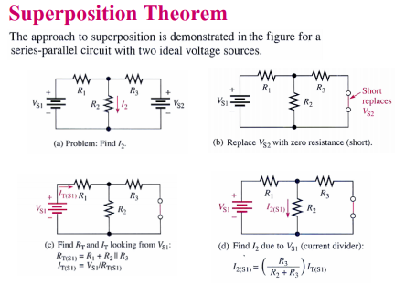

Slide 6
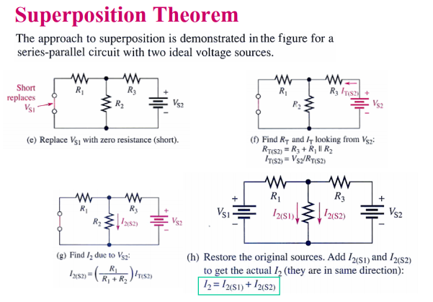

Slide 7
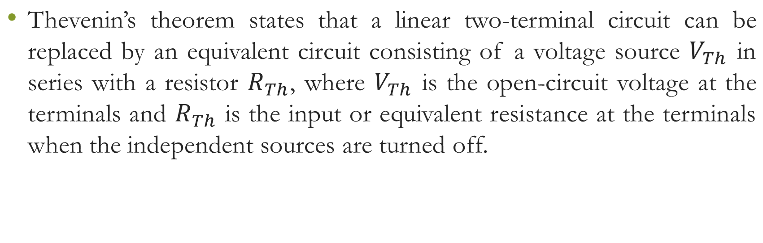
Thevenin’s Theorem

Slide 8
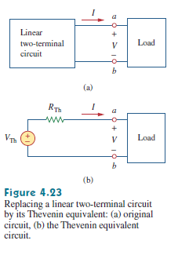

Slide 9
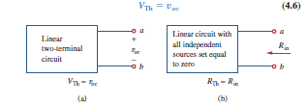

Slide 10
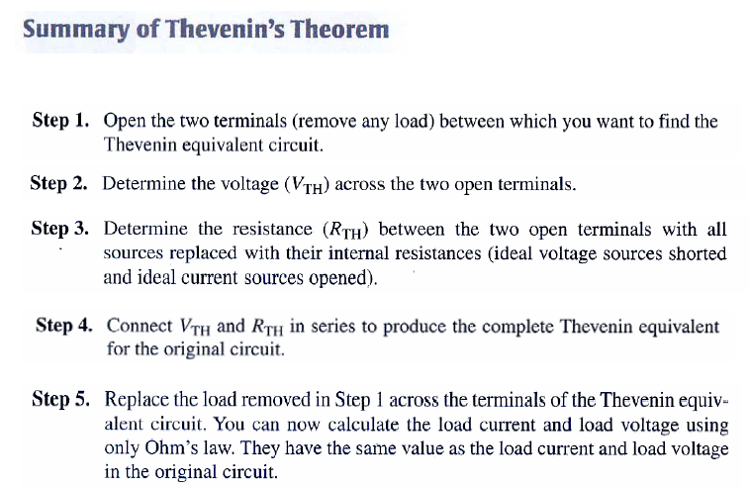

Slide 11
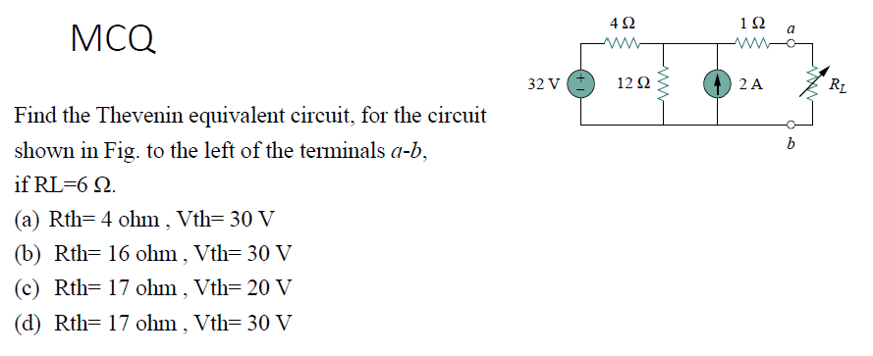

Slide 12
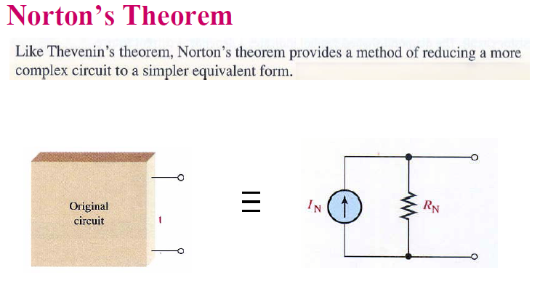

Slide 13
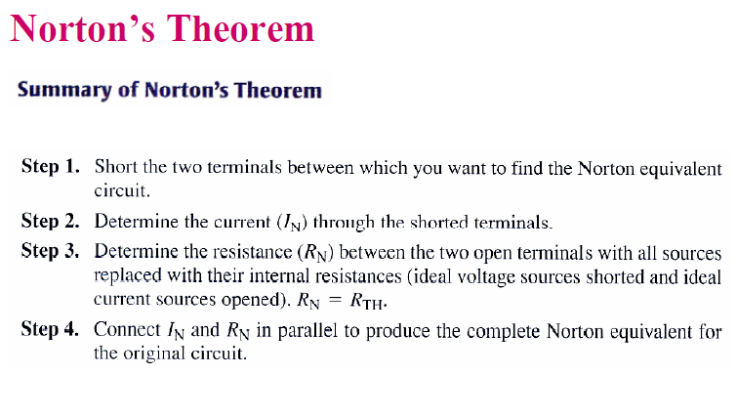

Slide 14
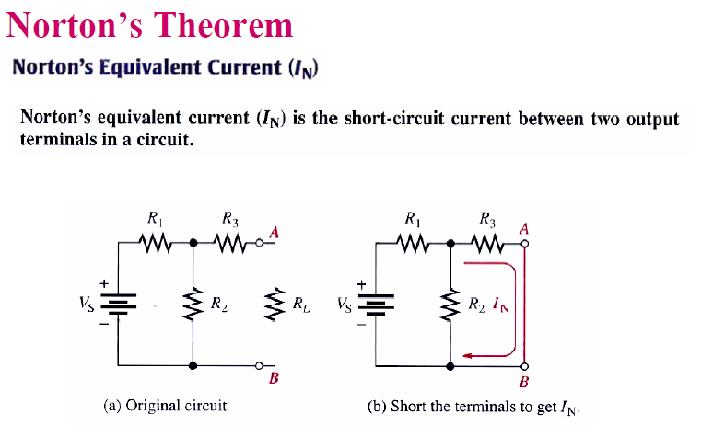

Slide 15
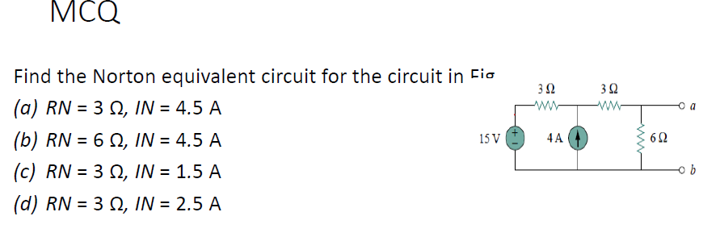

Slide 16
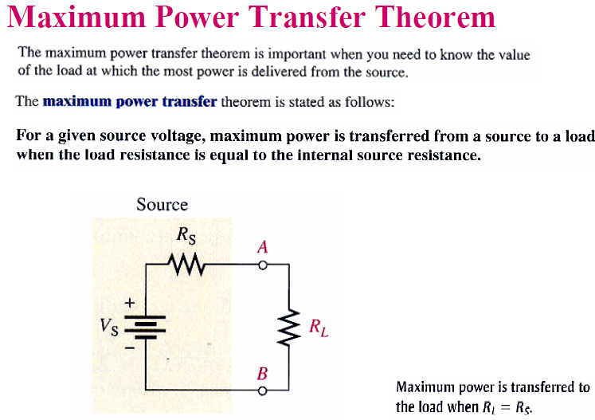

Slide 17
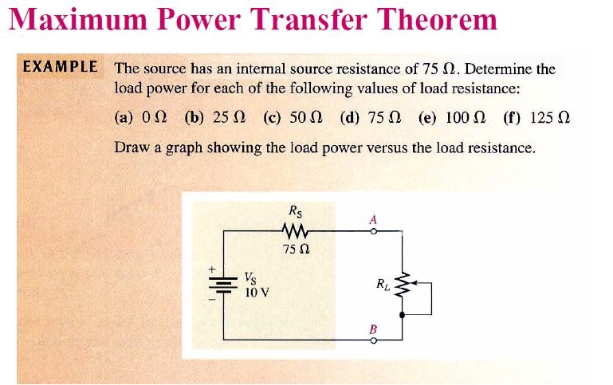

Slide 18
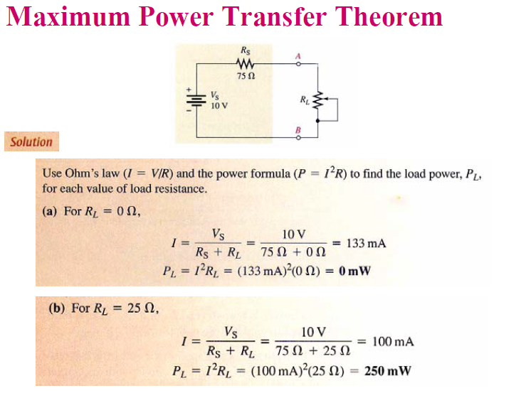

Slide 19
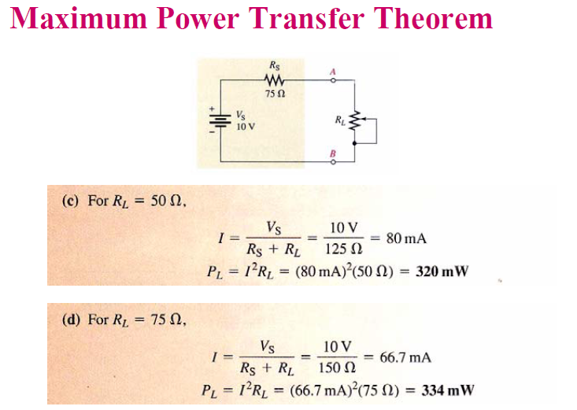

Slide 20
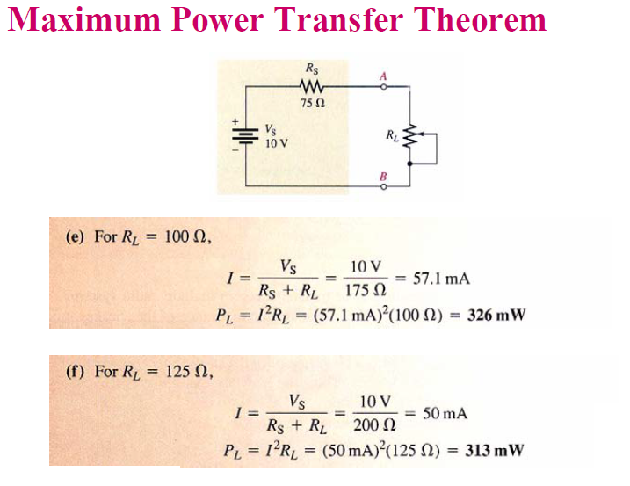

Slide 21
